Slide 1
Measuring preferences
Science and scenarios
Abatement costs
Instruments for emission reduction
Impacts of climate change; valuation
Economic impacts; marginals; distribution
Impacts and development
Adaptation policy
Optimal climate policy
Discounting, uncertainty, equity
Measuring preferences

Slide 2
Preferences
Optimal climate policy depends on how we define better and best
We may want to take advise from Socrates, Jesus , Lao Tzu, Mohammed, Lord Stern or Lady Gaga
We may also want to measure people’s
time preference
risk aversion
inequity aversion
But how?

Slide 3
Revealed Preferences
As with monetary valuation, we’d rather infer preferences from actual behaviour
However, intertemporal decisions are always risky and maybe altruistic
e.g., study to better the world
Risky behaviour may be pathological or altruistic
Altruism may be reciprocal
Turn to surveys, stated preferences
Experiments with low stakes

Slide 4
Time preference

Slide 5
Time preference

Slide 6



Time preference
$$DF={β\left(1−\left(1−θ\right)rt\right)}^{1/{1−θ}}$$
$$DF=e^{−rt},β=θ=1$$
$$DF={\left(1+rt\right)}^{−1},β=1 and θ=2$$

Slide 7
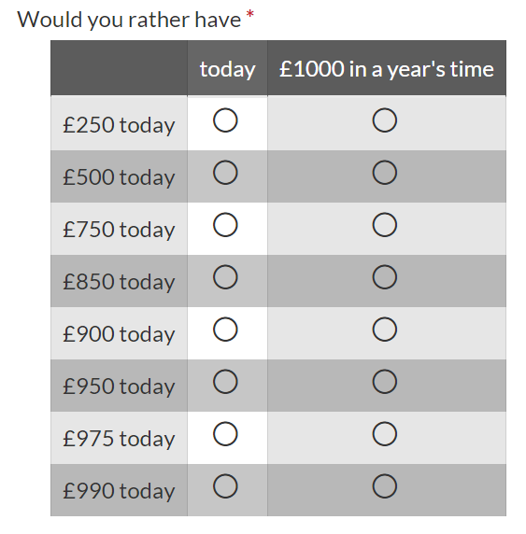
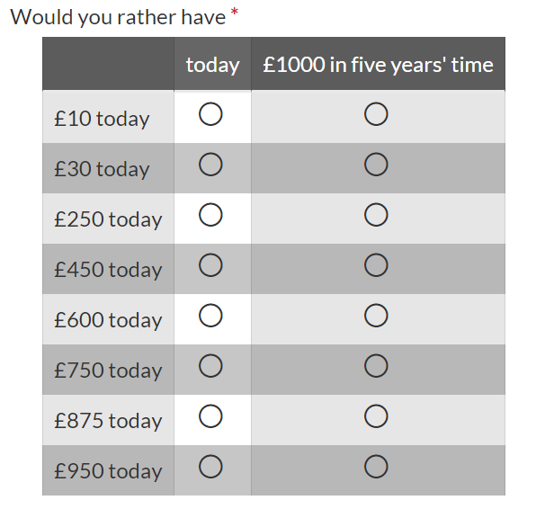
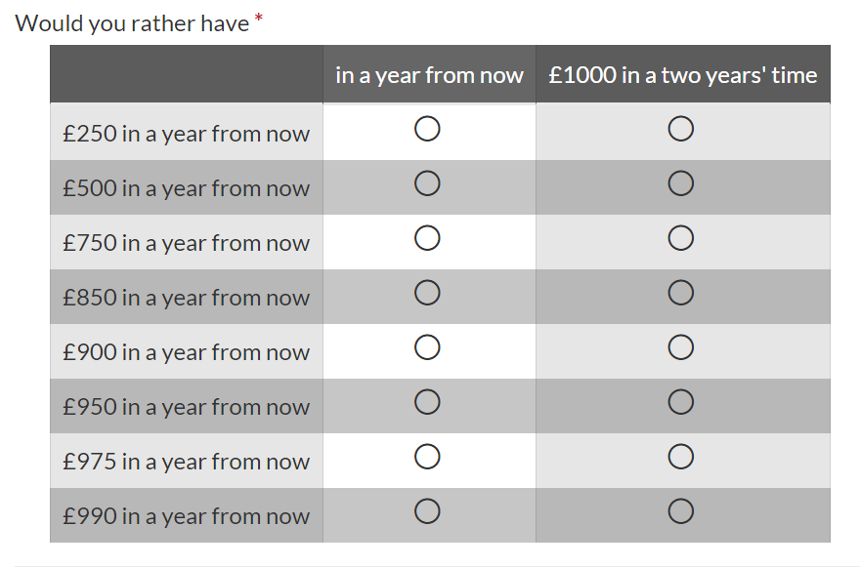
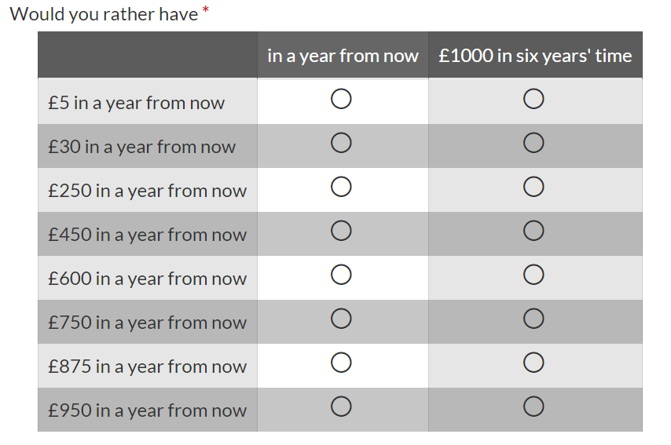

Slide 10
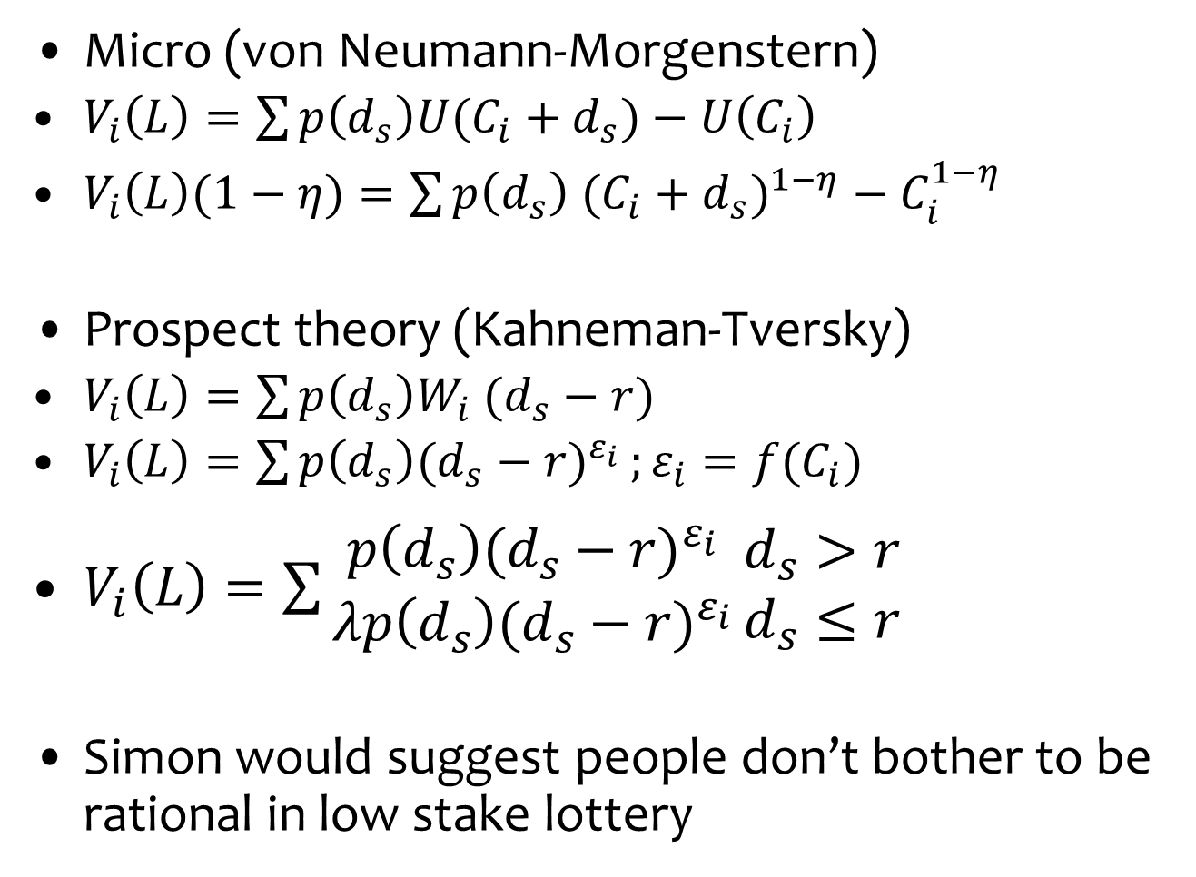
Risk preference
Micro (von Neumann-Morgenstern)
$V_{i}\left(L\right)=\sum{p\left(d_{s}\right)U(C_{i}+d_{s})}−U\left(C_{i}\right)$
$V_{i}\left(L\right)(1−η)=\sum{p\left(d_{s}\right) {(C_{i}+d_{s})}^{1−η}}−C_{i}^{1−η}$
Prospect theory (Kahneman-Tversky)
$V_{i}\left(L\right)=\sum{p\left(d_{s}\right)W_{i} (d_{s}−r)}$
$V_{i}\left(L\right)=\sum{p\left(d_{s}\right){(d_{s}−r)}^{ε_{i}}};ε_{i}=f(C_{i})$
$V_{i}\left(L\right)=\sum{\begin{matrix}p\left(d_{s}\right){(d_{s}−r)}^{ε_{i}} \\ λp\left(d_{s}\right){(d_{s}−r)}^{ε_{i}}\end{matrix}}\begin{matrix}d_{s}>r \\ d_{s}≤r\end{matrix}$
Simon would suggest people don’t bother to be rational in low stake lottery

Slide 11
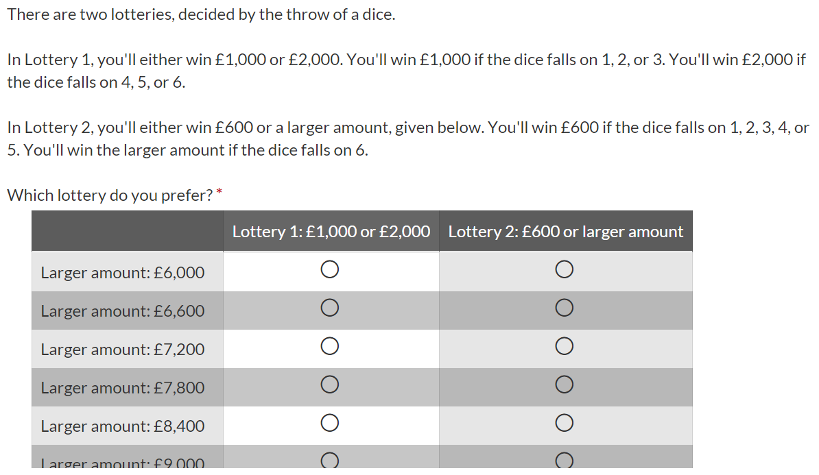
Ask for choice between two lotteries because people
may be biased towards sure things.

Slide 12
If someone accepts Lottery 2 for £6000, then she must be
risk neutral or risk loving.
If someone on an income of £29000 per year rejects
Lottery 2 for £6600, then her risk aversion aversion
must be smaller than 1.4.
If she rejected Lottery 2 for £6000, then her risk
aversion lies between 0.0 and 1.4.

Slide 14
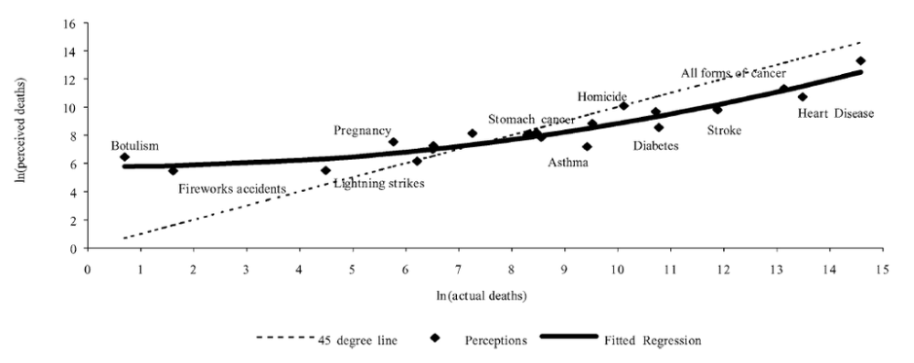

Slide 15
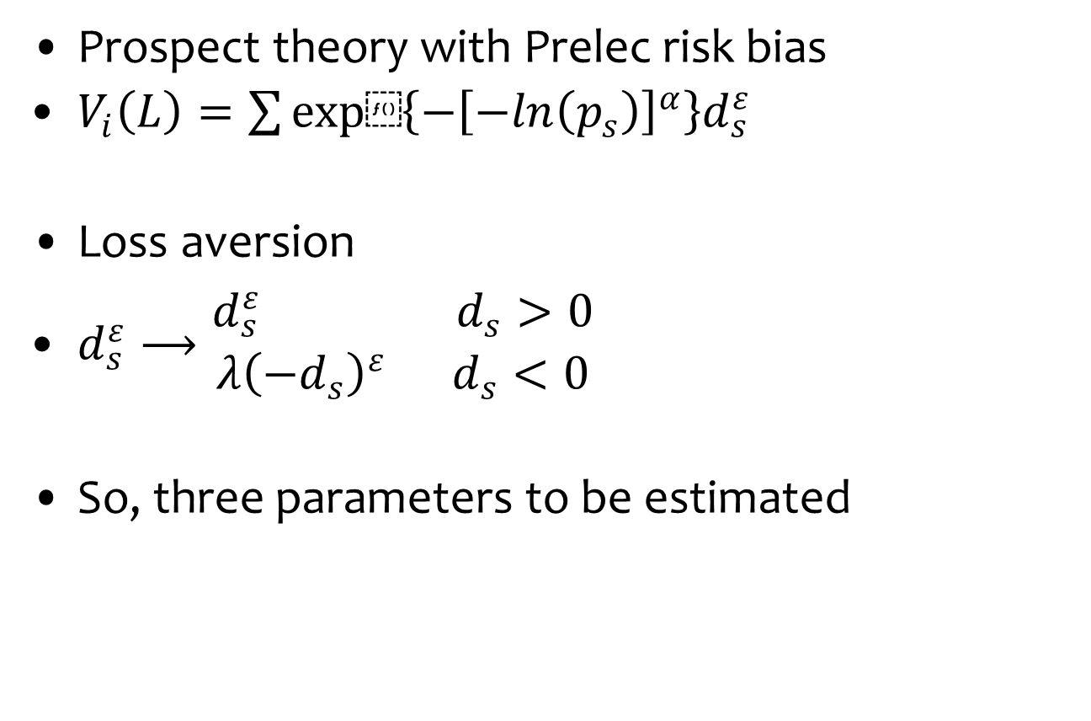
Risk preference
Prospect theory with Prelec risk bias
$V_{i}\left(L\right)=\sum{exp⁡\left\{−{\left[−ln\left(p_{s}\right)\right]}^{α}\right\}d_{s}^{ε}}$
Loss aversion
$d_{s}^{ε}⟶\begin{matrix}d_{s}^{ε} d_{s}>0 \\ λ{\left(−d_{s}\right)}^{ε} d_{s}<0\end{matrix}$
So, three parameters to be estimated

Slide 16
Inequity aversion
Fairness
How to divide a windfall among a group of people?
Equity
What is the best income distribution in a population?
For fairness, play a dictator game
I give you £10 – divide it between yourself and another

Slide 17
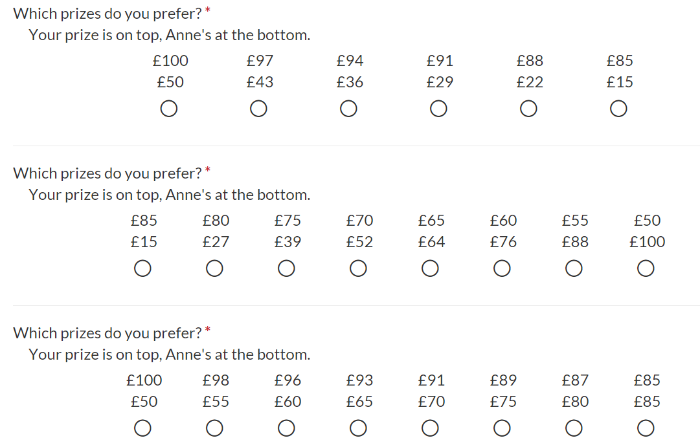

Slide 21
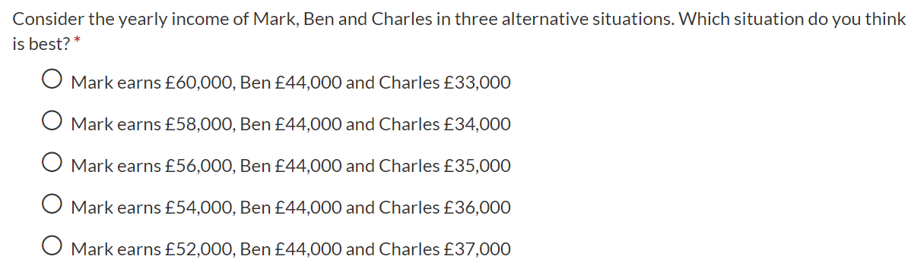
Inequity aversion
Fairness
How to divide a windfall among a group of people?
Equity
What is the best income distribution in a population?
Choice experiment with leaky bucket

Slide 22
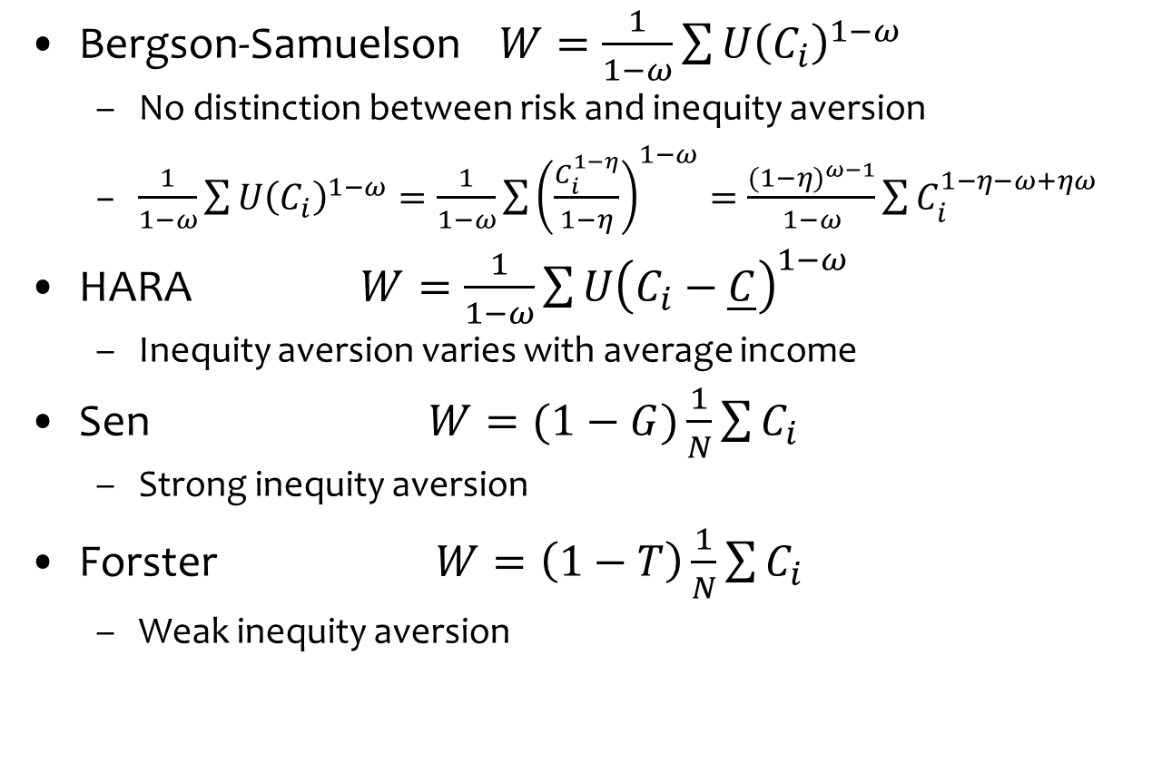
Inequity aversion
Bergson-Samuelson $W=\frac{1}{1−ω}\sum{{U\left(C_{i}\right)}^{1−ω}}$
No distinction between risk and inequity aversion
$\frac{1}{1−ω}\sum{{U\left(C_{i}\right)}^{1−ω}}=\frac{1}{1−ω}\sum{{\left(\frac{C_{i}^{1−η}}{1−η}\right)}^{1−ω}}=\frac{{(1−η)}^{ω−1}}{1−ω}\sum{C_{i}^{1−η−ω+ηω}}$
HARA $W=\frac{1}{1−ω}\sum{{U\left(C_{i}−\underline{C}\right)}^{1−ω}}$
Inequity aversion varies with average income
Sen $W=(1−G)\frac{1}{N}\sum{C_{i}}$
Strong inequity aversion
Forster $W=\left(1−T\right)\frac{1}{N}\sum{C_{i}}$
Weak inequity aversion

Slide 25
Conclusion
Ethical parameters – discount rate, risk aversion, inequity aversion – have a large impact on optimal climate policy
Parameters can be set based on moral reasoning, but whose morals?
Empirical evidence provides only limited guidance
Sensitivity analysis and humility are key

